Slide 1
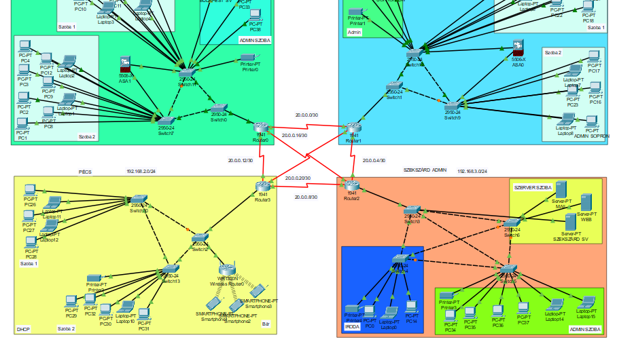
Stake Casino
Haramia Balázs, Farkas Kristóf, Müller János

Slide 2

Stake Network Presentation
Stake Casino Network
4 cities
Central managed
Budapest, Sopron, Pécs, Szekszárd
Notes:
The Stake Casino Network is currently distributed across four locations. We have casinos in Budapest, Sopron, Pécs, and Szekszárd. it's centrally managed, which allows us to maintain consistent security protocols and monitor all traffic from one primary location without needing local IT teams at every site.

Slide 3

The Stake team
Haramia Balázs (PM)
Farkas Kristóf
Müller János

Slide 4
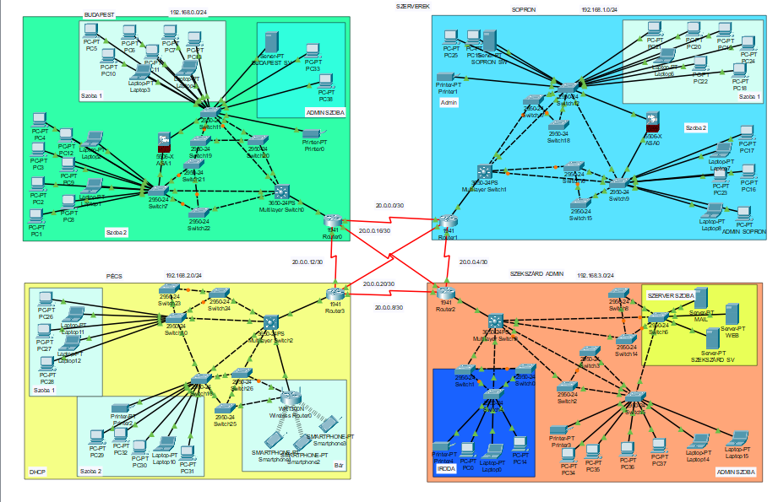
Overview
4 city: Budapest, Sopron, Pécs, Szekszárd
Protocols
Redundancy
Notes:
We are present in four cities, with Szekszárd serving as the administrative city. We use protocols such as RIP and GRE VPN. Both Layer 2 and Layer 3 redundancy are implemented, meaning that if one connection fails, the network continues to operate normally through another connection.
RIP: We used it for traffic routing. With the help of RIP, machines located in different networks can communicate with each other.
NAT: We used NAT to translate multiple internal private IP addresses into a single external public IP address.

Slide 5
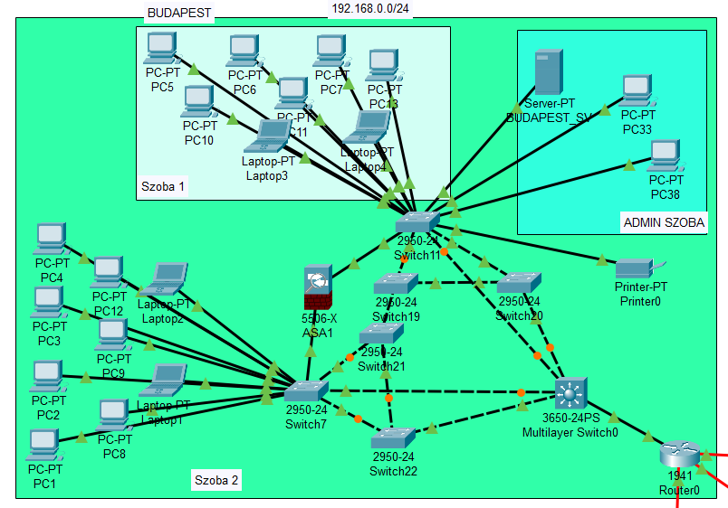
Budapest
Rooms: 2 + Admin
20 PC, 1 server, 1 printer
Firewall
Router: Connected to the Routers of the other 3 cities.
Notes:
Budapest: There are two rooms plus an admin room. A firewall is installed, which monitors incoming and outgoing traffic from the rooms, with stricter filtering applied to inbound traffic. Static IP addresses are assigned. There are 20 computers, 1 server, and 1 printer. Layer 2 redundancy is implemented, and the router is connected to the other three cities. Static IP addresses are used everywhere.
We have already started using IPv6 addresses here, and later we plan to extend IPv6 to the entire network due to the limited availability of IPv4 addresses.

Slide 6
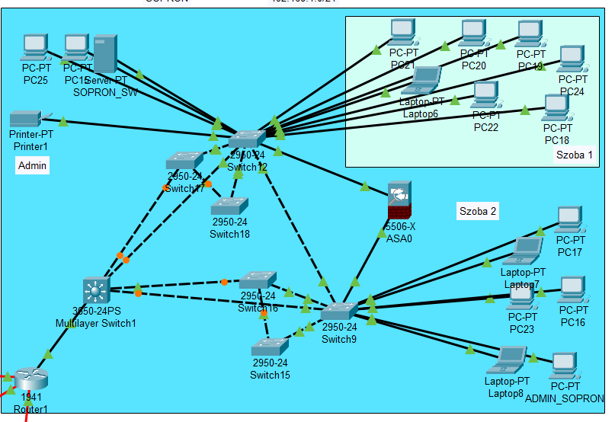
Sopron
Rooms: 2 + Admin
16 PC, 1 server, 1 printer
Firewall
Router: Connected to the Routers of the other 3 cities
Notes:
Sopron: There are two rooms plus an admin room. A firewall and an ACL are configured for the admin PC. The ACL filters traffic directed toward the admin machine, while the firewall monitors incoming and outgoing traffic from the rooms, with stricter filtering applied to inbound traffic. There are 16 computers, 1 server, and 1 printer. The router is connected to the other three cities, and Layer 2 redundancy is implemented here as well. Static IP addresses are used everywhere.

Slide 7
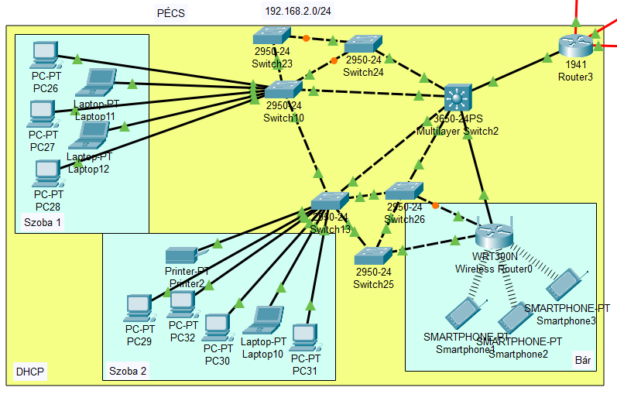
Pécs
Rooms: 2 + Bar
VLANs: Room 1, Room 2, Bar
DHCP
Wireless Router for the bar
Notes:
Pécs: There are two rooms plus a bar area. VLANs are configured, and devices within a VLAN can only communicate with other devices in the same VLAN; they cannot communicate with devices in a different VLAN. Room 1 uses static IP addressing, Room 2 also uses static IP addressing, while the bar area uses DHCP for IP assignment. There is a Wi-Fi connection in the bar. Layer 2 redundancy is implemented, and the router is connected to the other three cities.

Slide 8
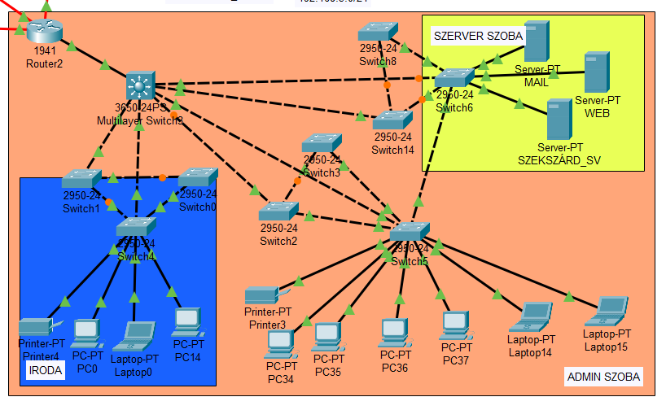
Szekszárd
Facilities: Office, Server room, Admin
12 PC, 2 printer, 3 server
Admin city
Notes:
Szekszárd: The administrative city. It includes an office, a server room, and an admin room. There are 12 computers, 2 printers, and 3 servers. The mail server (for handling emails) and the web server (for hosting the website) are located here. Static IP addresses are assigned at this site. Layer 2 redundancy is implemented, and the router is connected to the other three cities.
The servers were created in VirtualBox (one Windows and one Linux). Several services were configured on them, including: Active Directory, DHCP, DNS, HTTP/HTTPS, file and printer sharing, automated backups, and automated software deployment to client machines.

Slide 9
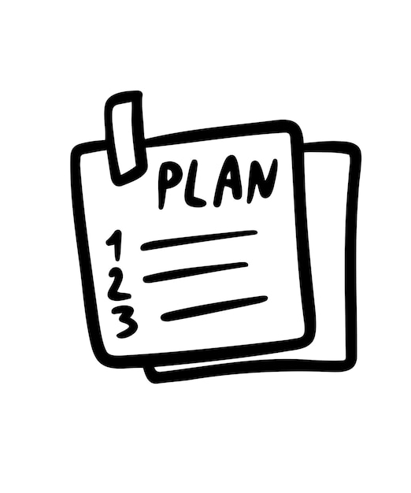
Future Plans
Security improvement
More firewalls
Establishing additional sites
Upgrading network devices
Notes:
Configuration of multiple ACLs and the use of stronger passwords. Procurement of additional firewalls and configuration of stronger firewall protection. Expansion of the network by integrating new cities and creating new rooms. Upgrading and modernizing network devices.

Slide 10
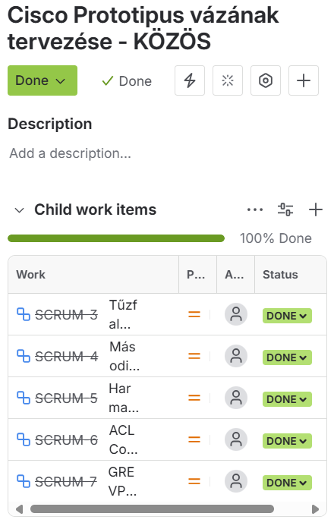
Jira documentation
Testing
Documenting
Logging working hours
Notes:
We used Jira for our project, its a very important tool, as when we had any tasks to do we used this, so we knew when we are done with it and if we got any other tasks to do. We could also see here how much time someone spent on the tasks which is very good.

Slide 11

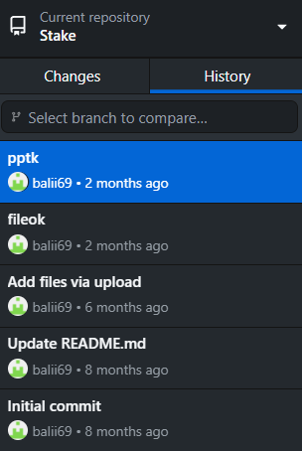
_Git_
Version control system
Transparent development
Notes:
We also used Git for our project. It is where we upload all of our files, so we can get them anytime, like if something happens, we can still get it from the Git, as we have everything saved there.

Slide 12
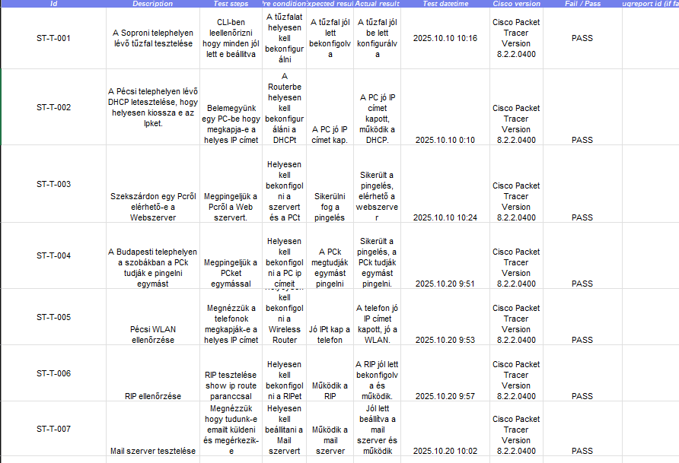

Testing
Network testing ensures that the system operates stably, quickly, and securely during everyday use.
Notes:
We tested a lot in our network to find bugs, its a very important thing as we found some bugs thanks to this, and fixed them. We used a table for the testing as you can see, it was very easy to see everything.

Slide 13
Diagram
21 óra
47 óra
38 óra
Notes:
This diagram shows how much time we spent on the project.

Slide 14

Summary
Each city is on its own subnet
01
Redundant and secure network architecture
02
Unified DNS and logical IP structure
03
Stable connection between the casinos
04

Slide 15
Thank you for listening!
☺

